Slide 1
EXPLORATORY DATA ANALYSIS : TASK 1
Poromendro Nath Burman
9/15/20

Slide 2
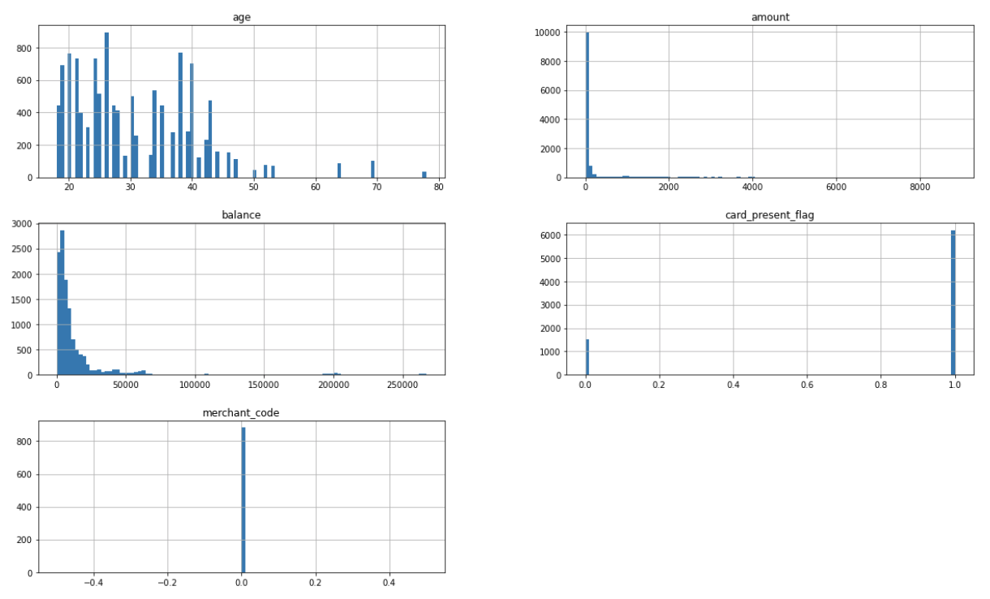
DATA ANALYSIS RESULTS
Visual representation of numerical columns of the dataset
It seems most of the customers are below the age of 50.
Most of the transaction amounts are below $50.
2. Top 5 transaction amounts
Transaction Amount | Total
33.0 | 168
39.0 | 119
29.0 | 116
36.0 | 107
45.0 | 102
3. Currency used in dataset : AUD
4. Different movements used in the dataset : Credit, Debit

Slide 3
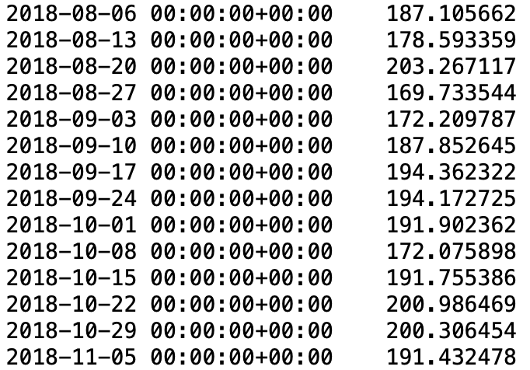
DATA ANALYSIS RESULTS
4. Average transaction amount : $187.933588
5. Average transaction for each month :
Month | Average Transaction
August | 185.121867
September | 182.045903
October | 196.427323
6. Average transaction for each week :

